Slide 1
Spraying Technology stationary test equipment
Kris Ruysen
Afd. Milieu & Techniek

Slide 2
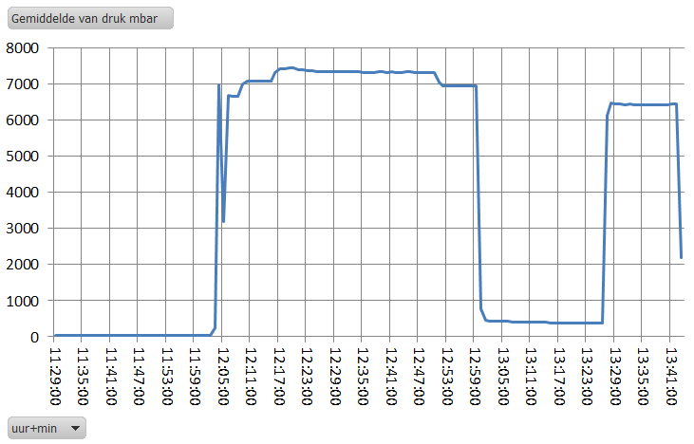
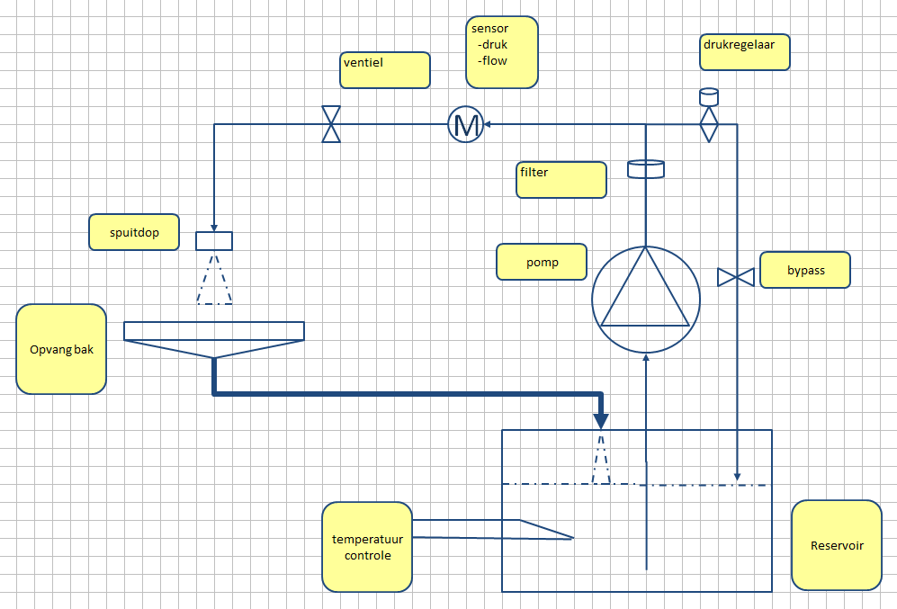
Test spraying liquids on clumping
Problems on clumping will disturb the application
Simulation of a day spraying (free programmable)
F.e: spraying – stop spraying – start again spraying - ……….
Continuous measurement of
Flow rate
Pressure
Fluid Temperature
Environment ( Temperature, Dew point)
Evaluation of different
Spray Nozzle types
Mix nozzles types
Products, Formulations, Surfactants
Pulsating applications
Spray pressure
Filters

Slide 3
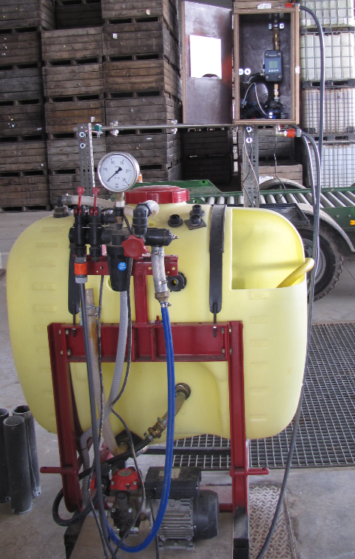
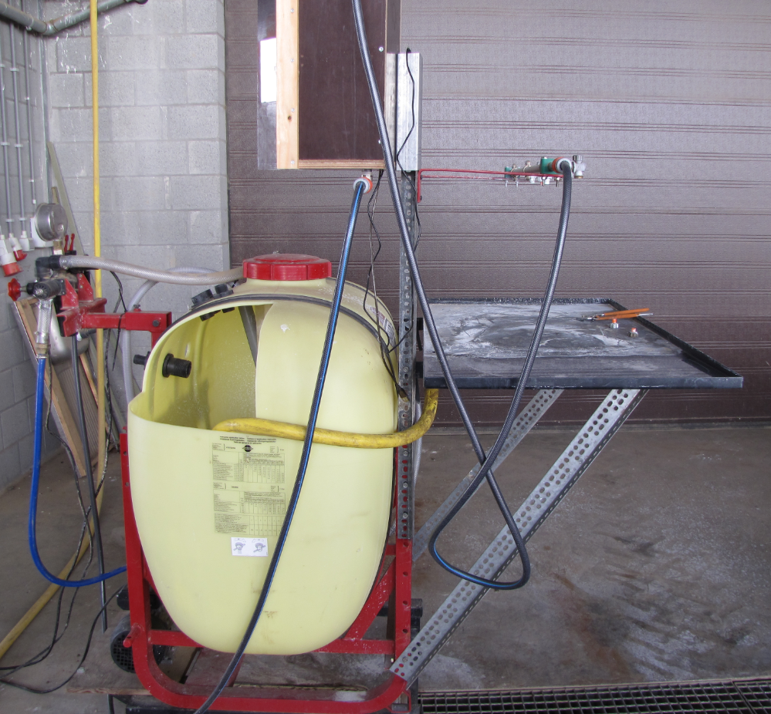

Slide 4
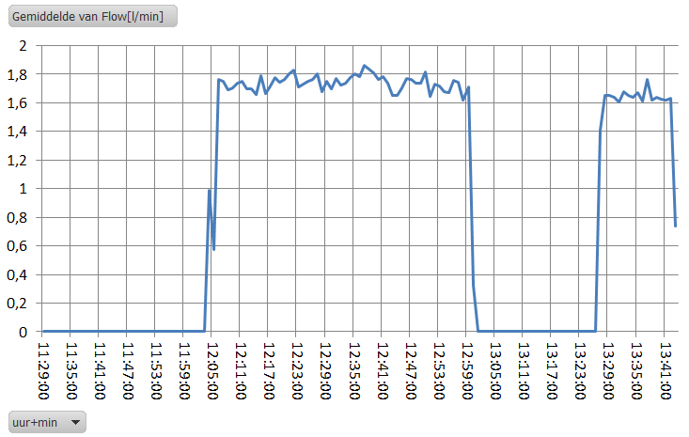
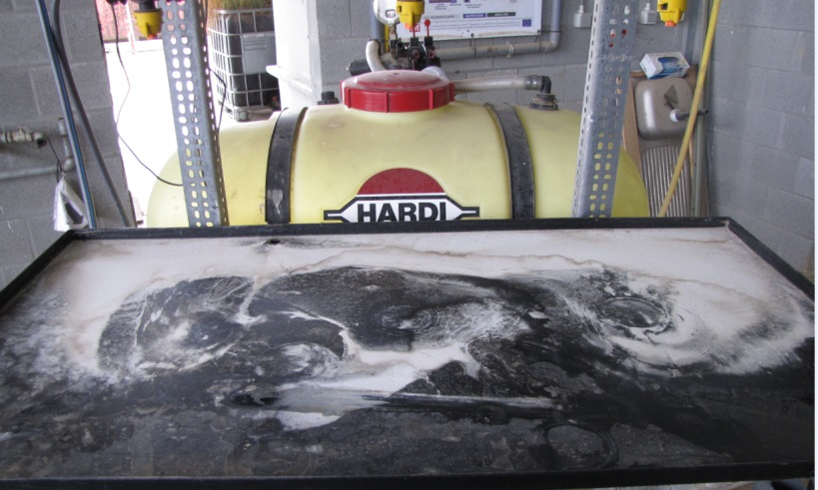
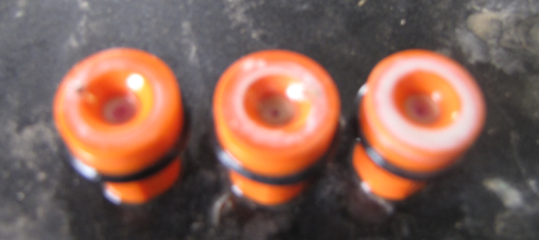
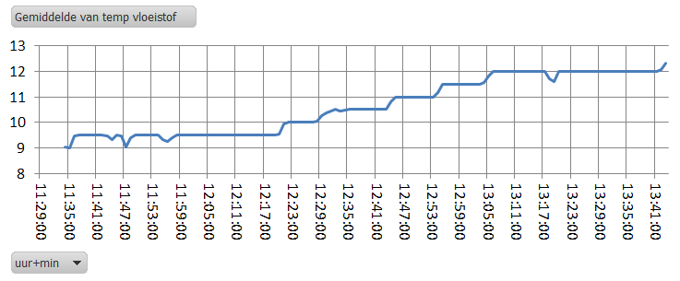
Example
Aliette 2kg / 100l
Marpan 0,6 kg /100l

